Slide 1
NH Traffic Stop Data
Jen Legere, Jeremy Dickinson, Amy Chang, Maz Hejazi, Frawley Barton
Notes:
Maz

Slide 2
Insights
Are you more likely to get a ticket at the end of the month?

Slide 3
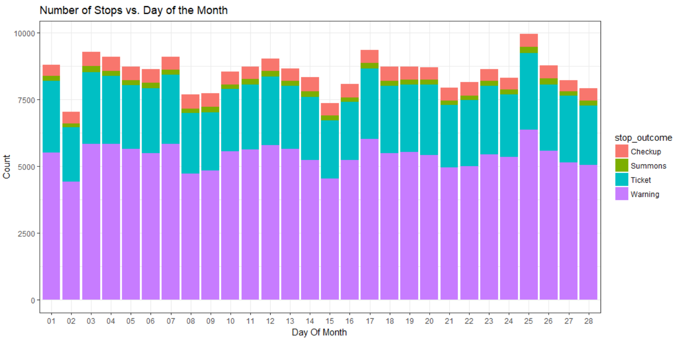
Do more traffic stops occur at the end of the month?

Slide 4
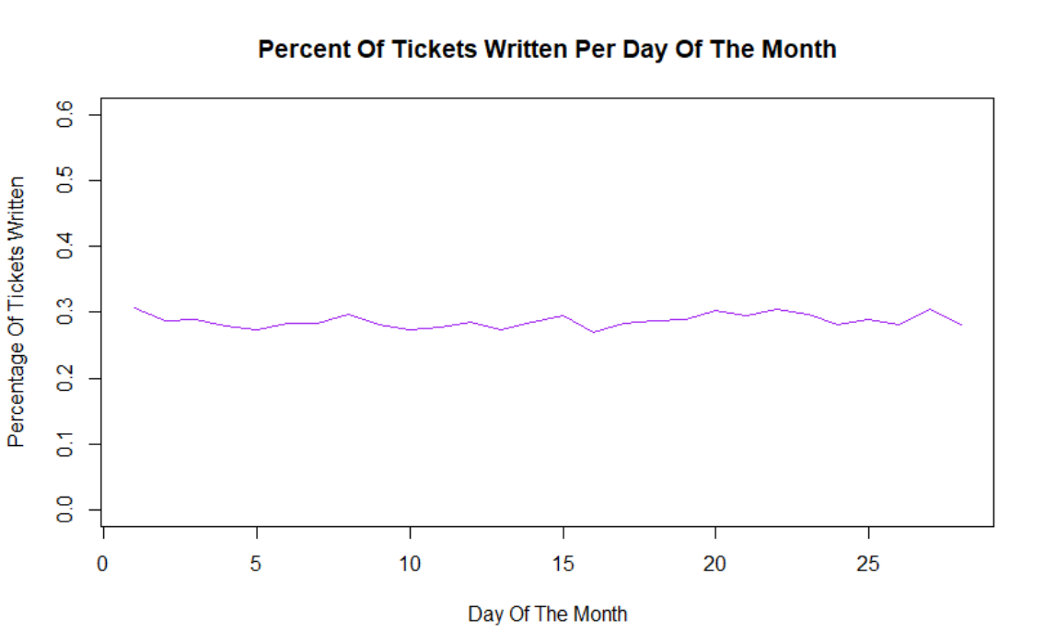
What percentage of traffic stops result in a ticket?
The “monthly quotas” theory is a myth!!

Slide 5
Insights
Are you more likely to get a ticket at the end of the month?
What hours of the day are you more likely to get stopped?

Slide 6
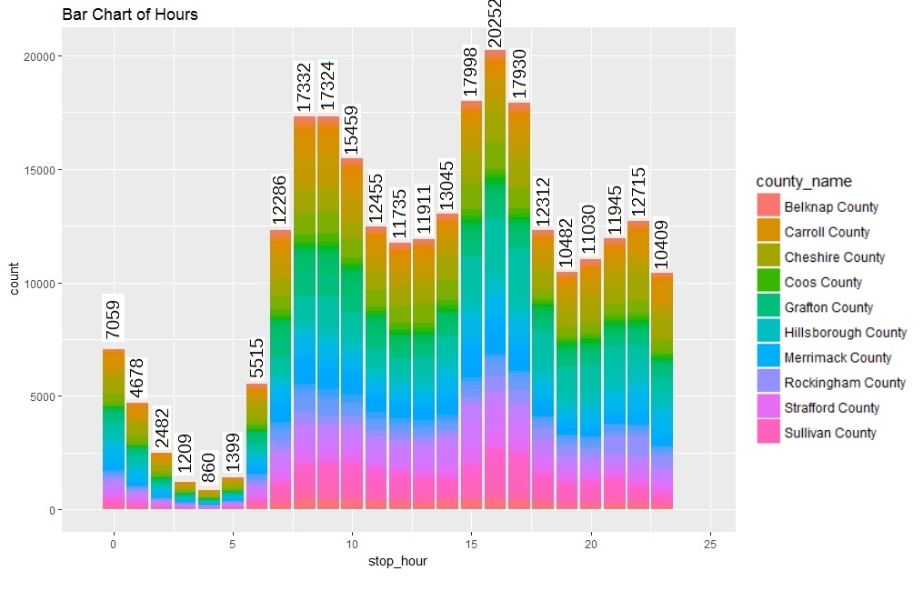
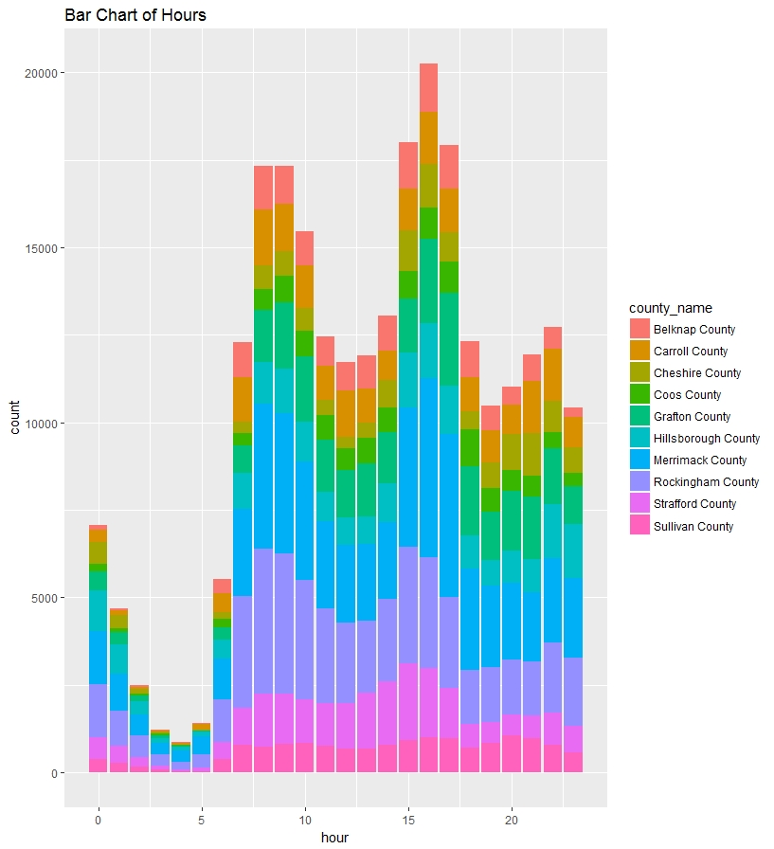
Number of Traffic Stops
What hours of the day have the highest and lowest number of traffic stops?

Slide 7
Insights
Are you more likely to get a ticket at the end of the month?
What hours of the day are you more likely to get stopped?
Do out-of-state residents get more tickets?

Slide 8
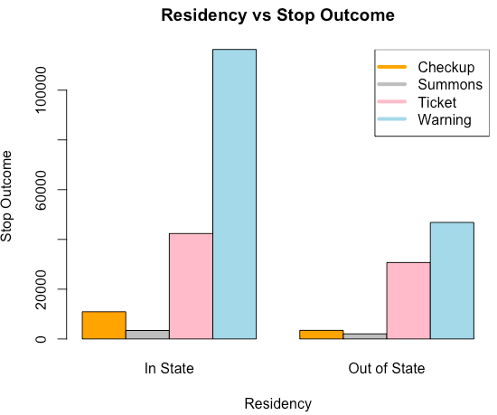
Do out-of-state residents get more tickets?
In state residents have a higher percentage of warnings than out of state residents

Slide 9
Insights
Are you more likely to get a ticket at the end of the month?
What hours of the day are you more likely to get stopped?
Do out-of-state residents get more tickets?
Do men get more tickets than women?

Slide 10
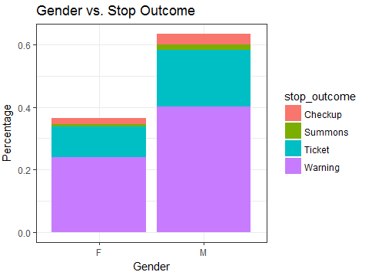
Do men get more tickets than women?

Slide 11
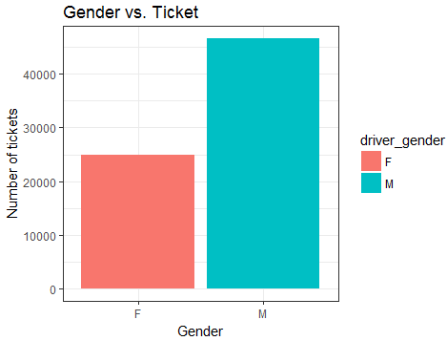
Do men get more tickets than women?

Slide 12
Insights
Are you more likely to get a ticket at the end of the month?
What hours of the day are you more likely to get stopped?
Do out-of-state residents get more tickets?
Do men get more tickets than women?
Do women get more warnings than men?

Slide 13
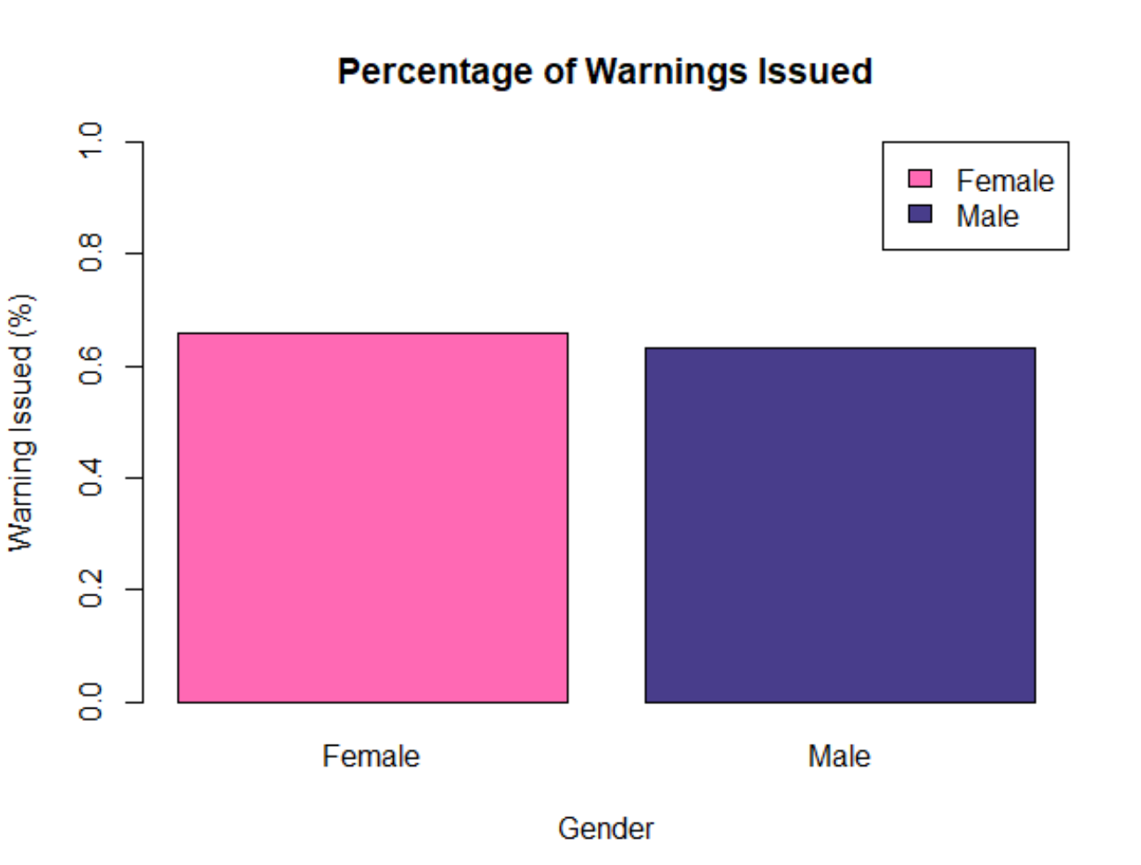
Do females get issued a warning more often than males?
Female: 65.9%
Male: 63.1%

Slide 14
Questions?

